Slide 1
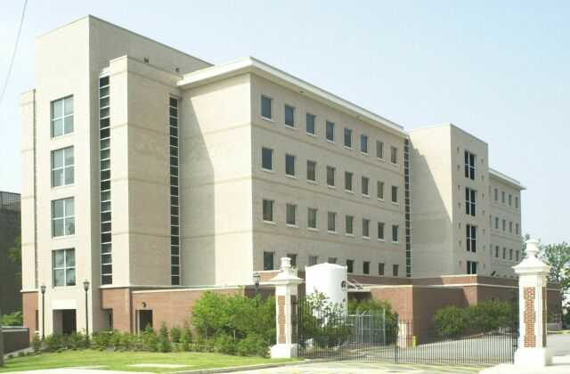
Energy flow in quantum systems J. Phys. Chem. A 2021, 125 (21), 4653–4667
Sophya Garashchuk
Vitaly Rassolov
Covid explorations

Slide 2
Plan and main ideas
Overview
Dynamics
Bohmian formulation
Define and derive local energy
Not unique in quantum systems
This is general quantum feature
Our definition is consistent with classical limit
(still not unique)
And with Bohmian formalism
Study four model systems
Mostly 1D
Simplified model double well (analytic)
Meta-stable well (numerical)
Also 2D Quantum-Classical
Lessons for the quantum dynamics community
Very hard to do exact quantum using Bohmian formalism
In transition to the classical regime, quantum effects become rare (rather than small)

Slide 3
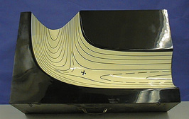
Potential energy surface describes electronic energy and Coulomb repulsion between nuclei.
Chemical reaction dynamics can be represented classically as motion of a marble on this surface
In practice, one needs many marbles to gather statistics. To represent experimental conditions, marbles should start with different velocities and positions (phase space sampling)
Simplest quantum effects are described by assigning individual marbles to particular quantum states (quasiclassical description).

Slide 4
The simplest quantum effect in nearly classical systems is zero-point-energy (ZPE) correction
Think of a quasiclassical picture, with the system represented by an ensemble of trajectories
At present, there is no simple way to account for ZPE along a reaction. Important: ZPE is a property of the whole ensemble, not each trajectory.
What could be the way to describe ZPE-like quantum effects?
A simple way is to compute the spread of trajectory ensemble, and “somehow” fit it to ZPE, then compute forces that come from ZPE.
In effect, this is what we do in our approximate Bohmian formulation, except it is done in a rigorous way:
ZPE dependence on spread is indirect; it is directly dependent on the average gradients of density
we introduce non-classical momentum, and obtain ZPE from it.

Slide 5
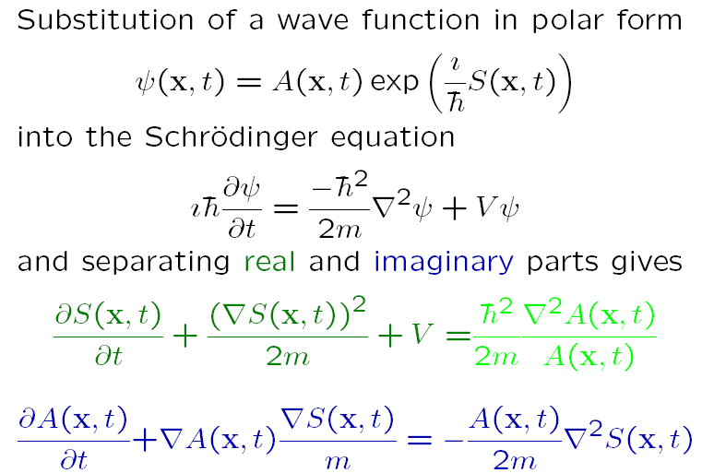
Bohmian formulation

Slide 6
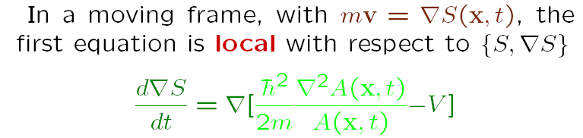
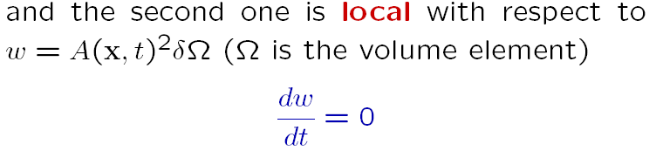
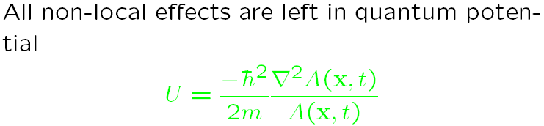
Bohmian formulation

Slide 7
Summary of traditional Bohmian approach
Quantum equations are written in classical way: wavefunctions are represented by trajectories, each moving according to classical mechanics + additional forces from Quantum Potential
Formulation is exact, and neatly compatible with molecular mechanics
Quantum potential is non-local, unbound, sometimes singular, and horribly unstable

Slide 8
New content. Derivations:
Next, we introduce two operators
Quantum trajectory operator
Local energy operator
Use these operators to introduce the “quantum power” expression
And apply it to model systems

Slide 9
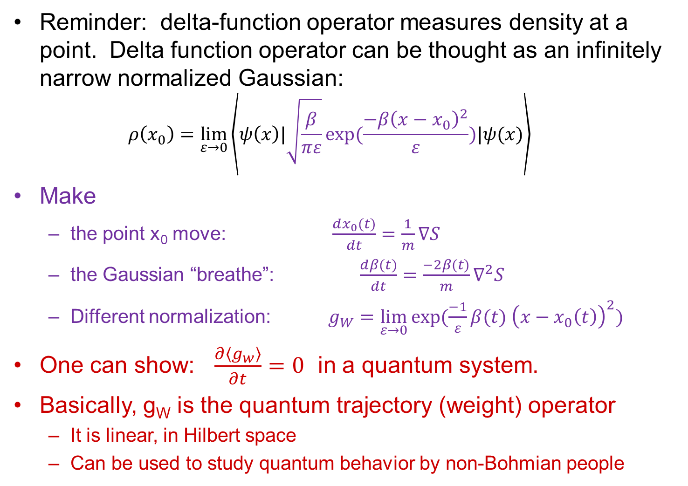
Quantum Trajectory Operator
Reminder: delta-function operator measures density at a point. Delta function operator can be thought as an infinitely narrow normalized Gaussian:
$$ρ\left(x_{0}\right)=\lim_{ε→0}\left\langle ψ\left(x\right)|\sqrt{\frac{β}{πε}}exp⁡(\frac{−{β\left(x−x_{0}\right)}^{2}}{ε})|ψ(x)\right\rangle$$
Make
the point x₀ move: $\frac{dx_{0}(t)}{dt}=\frac{1}{m}∇S$
the Gaussian “breathe”: $\frac{dβ(t)}{dt}=\frac{−2β(t)}{m}∇^{2}S$
Different normalization: $g_{W}=\lim_{ε→0}{exp⁡(\frac{−1}{ε}}β(t) {\left(x−x_{0}\left(t\right)\right)}^{2})$
One can show: $\frac{∂\left\langle g_{w}\right\rangle }{∂t}=0$ in a quantum system.
Basically, g_{W} is the quantum trajectory (weight) operator
It is linear, in Hilbert space
Can be used to study quantum behavior by non-Bohmian people

Slide 10
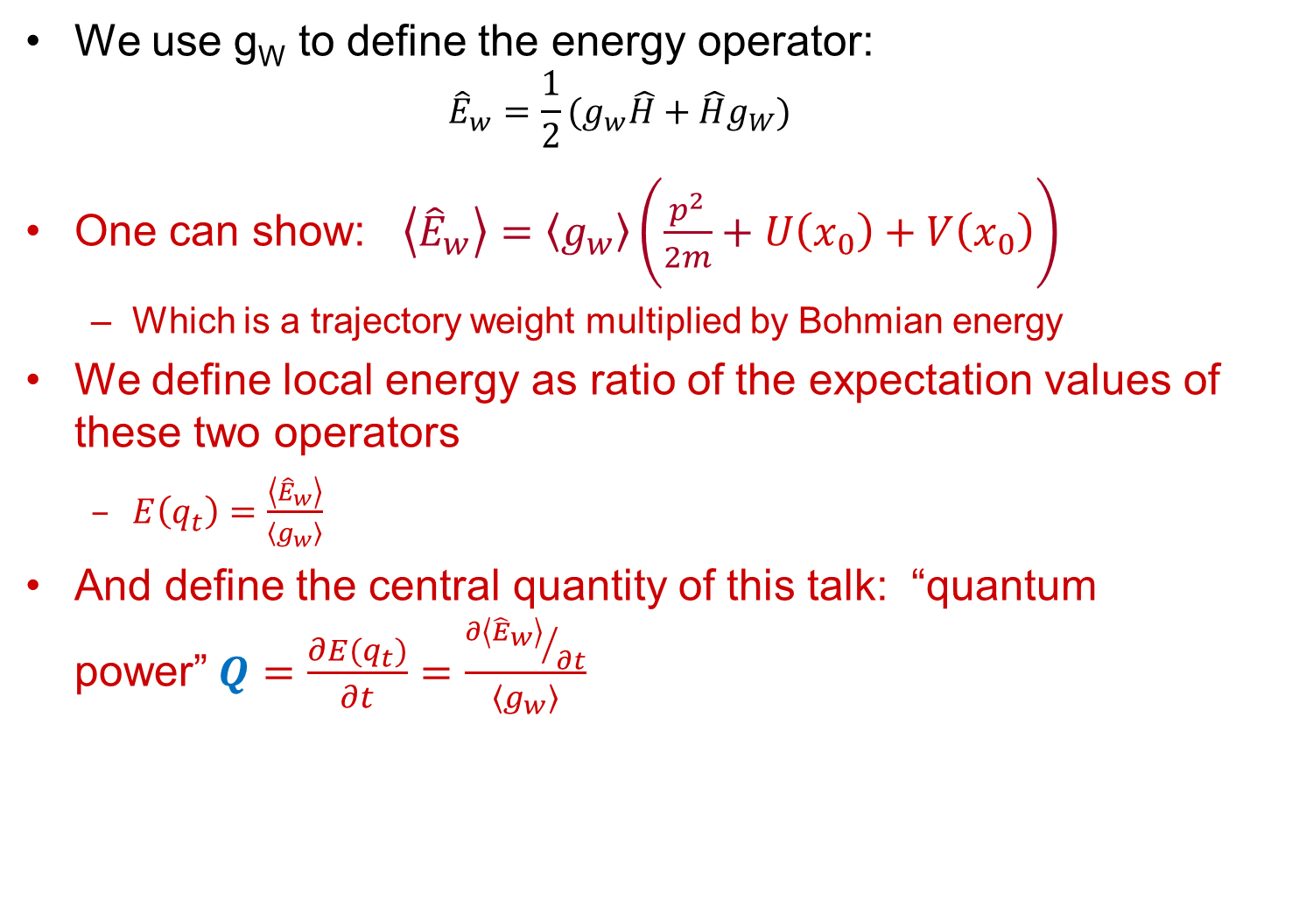
Local Energy Operator
We use g_{W} to define the energy operator:
$${\hat{E}}_{w}=\frac{1}{2}(g_{w}\hat{H}+\hat{H}g_{W})$$
One can show: $\left\langle {\hat{E}}_{w}\right\rangle =\left\langle g_{w}\right\rangle \left(\frac{p^{2}}{2m}+U\left(x_{0}\right)+V\left(x_{0}\right)\right)$
Which is a trajectory weight multiplied by Bohmian energy
We define local energy as ratio of the expectation values of these two operators
$E\left(q_{t}\right)=\frac{\left\langle {\hat{E}}_{w}\right\rangle }{\left\langle g_{w}\right\rangle }$
And define the central quantity of this talk: “quantum power”$Q=\frac{∂E(q_{t})}{∂t}=\frac{{∂\left\langle {\hat{E}}_{w}\right\rangle }/{∂t}}{\left\langle g_{w}\right\rangle }$

Slide 11
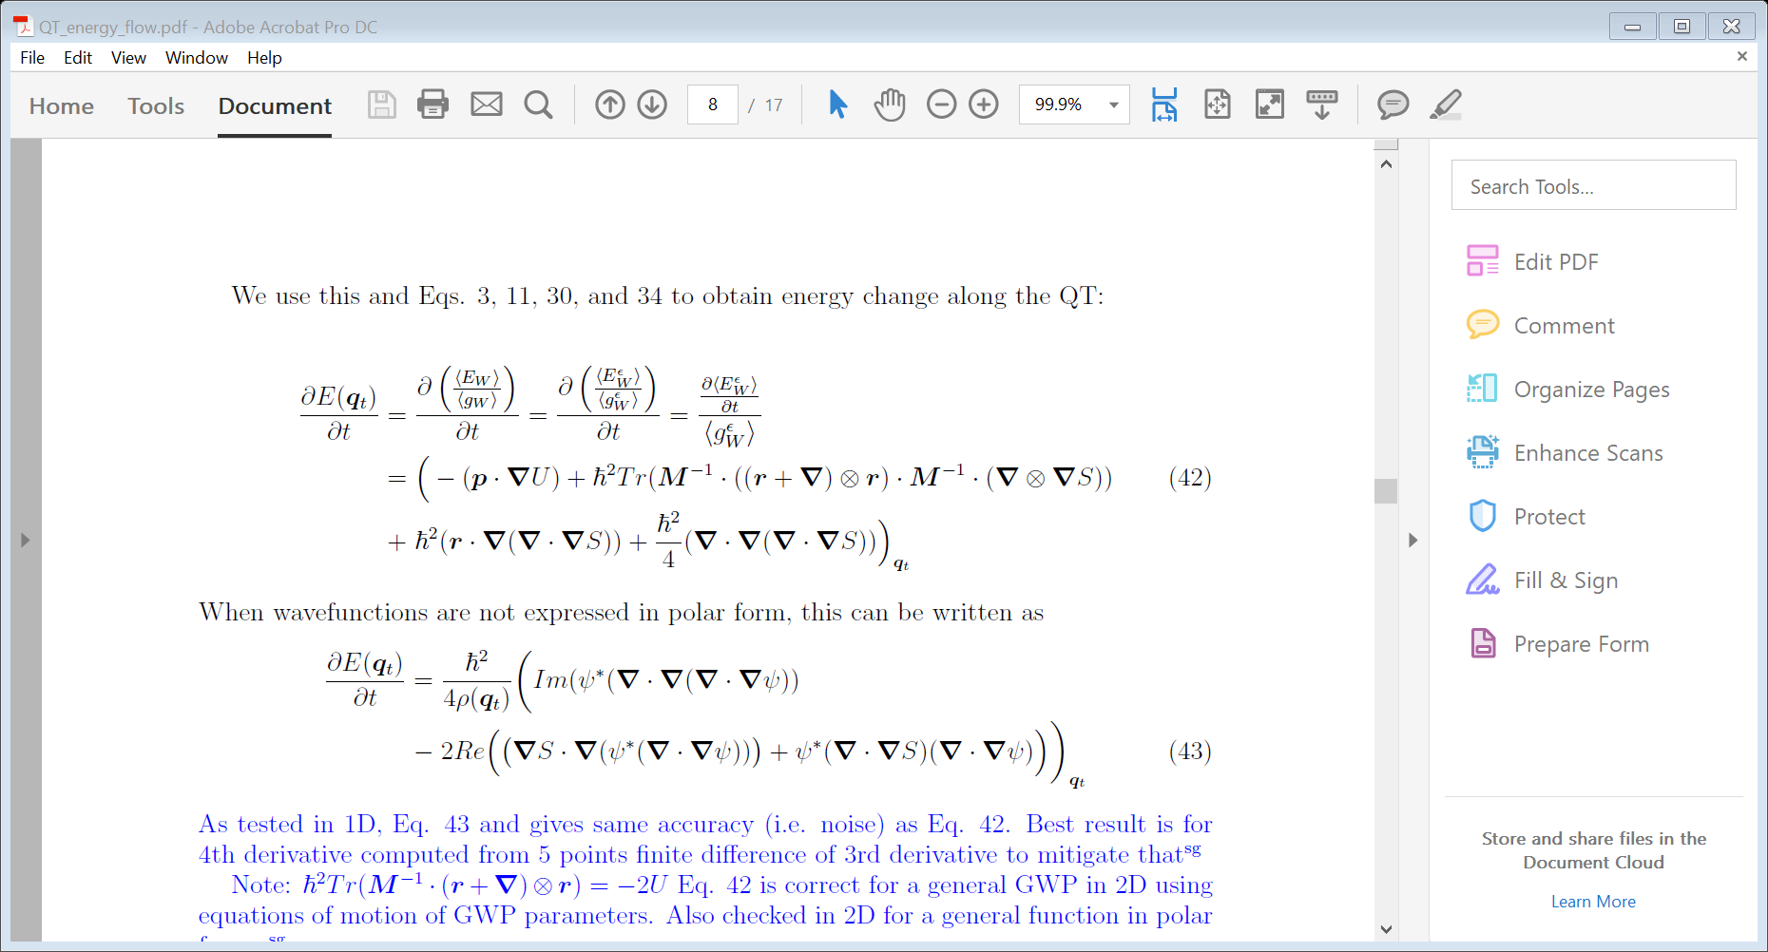
Local Energy Operator
We use Heisenberg representation to derive time derivative of local energy:

Slide 12
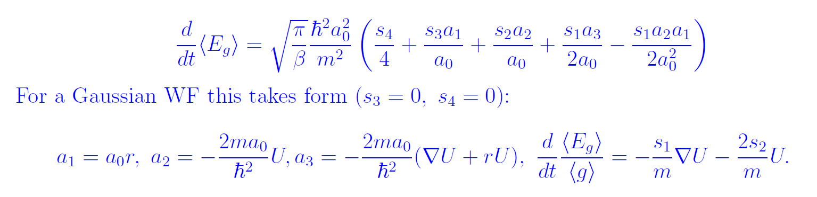
Time derivative, 1D
s_{i} and a_{i} are Taylor expansion coefficients of phase and amplitude. r is non-classical momentum, and U is quantum potential

Slide 13
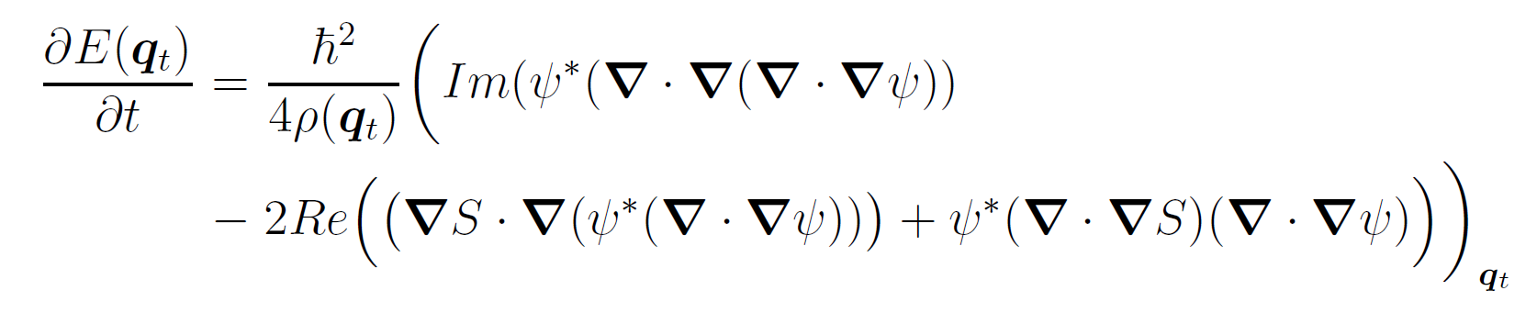
Quantum power properties
It is semiclassical (goes to zero when m → ∞ or ħ → 0 )
It does not depend on the external potential V
Given by a ratio of linear QM operators (i.e. meaningful even outside of Bohmian formalism, in traditional QM).

Slide 14
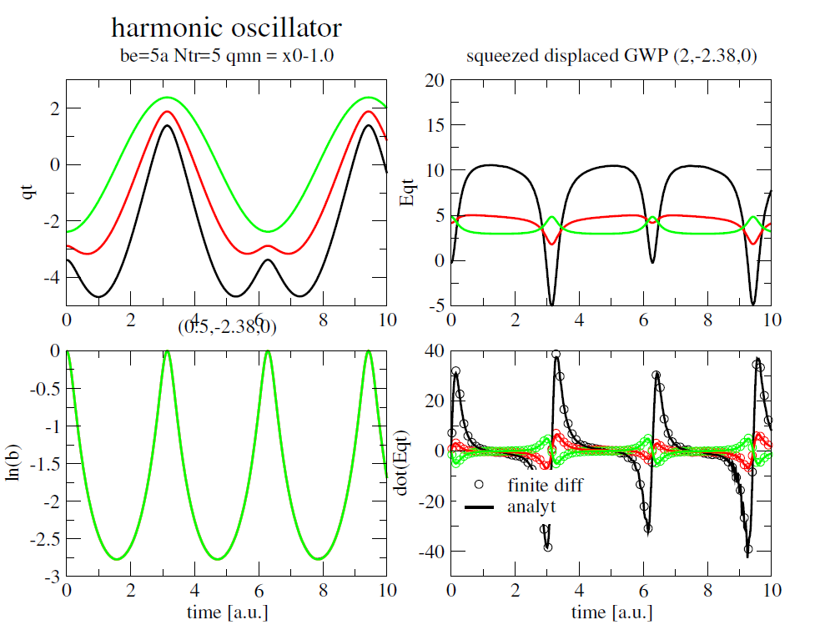
Systems (I): A Gaussian
Conclusion: periodic energy exchange among the trajectories, as expected

Slide 15
Systems (Ia): A Gaussian
The translational motion of a coherent Gaussian wavepacket in a parabolic potential. The QTs, shown as thin solid lines, track the dynamics of the wavefunction, whose footprints are marked as circles. The corresponding Q, is plotted as straight line segments for nine instances of time listed in the legend.
Conclusion: Energy from the trailing edge flows into the leading edge

Slide 16
Systems (Ib): A Gaussian
The breathing motion of an otherwise stationary Gaussian wavepacket in a parabolic potential. The snapshots of Q and |Ψ| are plotted for times indicated at the bottom of each panel. The vertical axis corresponds to Q in a.u.
Conclusion: Again, energy from the “trailing edge” flows into the “leading edge”

Slide 17
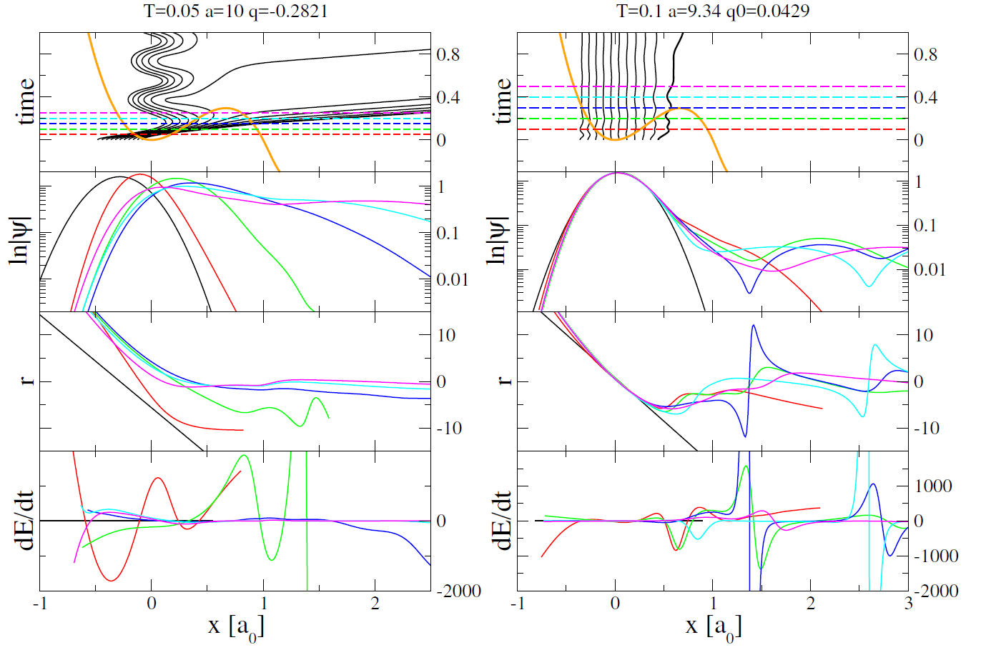
Systems (II): Metastable well
Conclusion: Energy exchange in the potential well helps trajectories to tunnel.

Slide 18
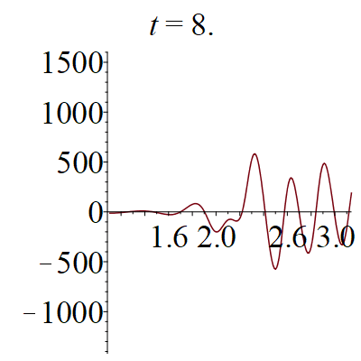
Systems (II): Metastable well long time, large x quasistatic limit
Conclusion: Energy exchange in the potential well helps trajectories to tunnel.

Slide 19
Systems (II ½): Eckart Barrier mimicking H + H₂ reaction barrier
Conclusion: Complicated dynamics at the barrier, constant recrossing

Slide 20
Systems (II ½): Eckart Barrier mimicking H + H₂ reaction barrier
Conclusion: Complicated dynamics at the barrier, indeed

Slide 21
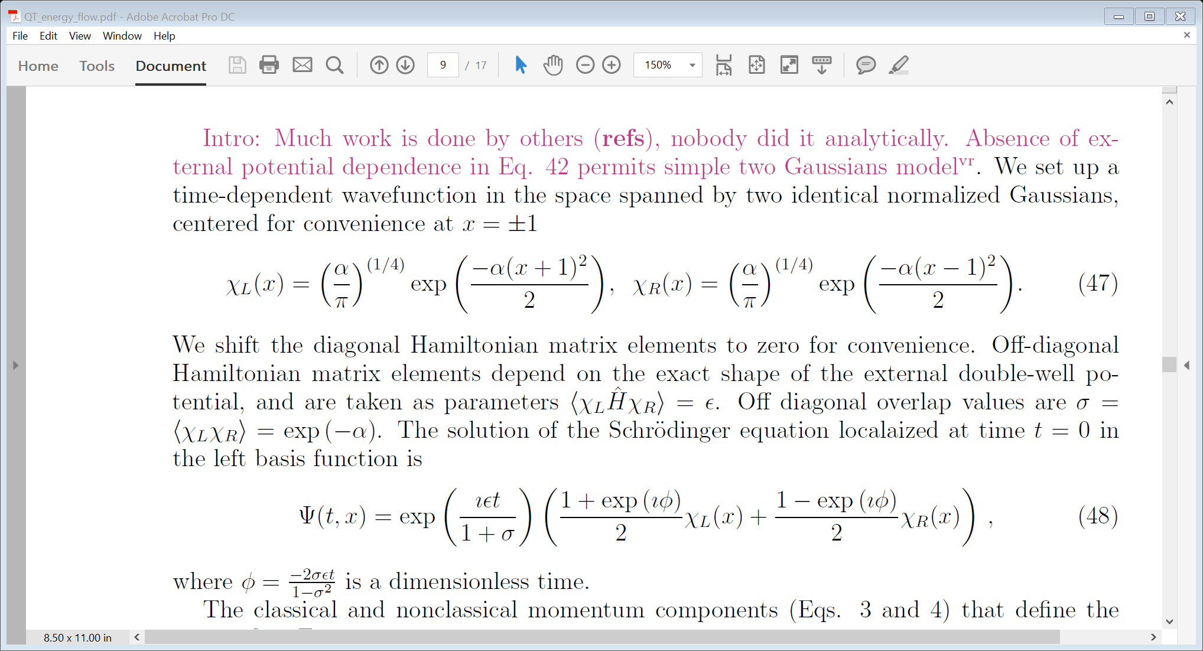
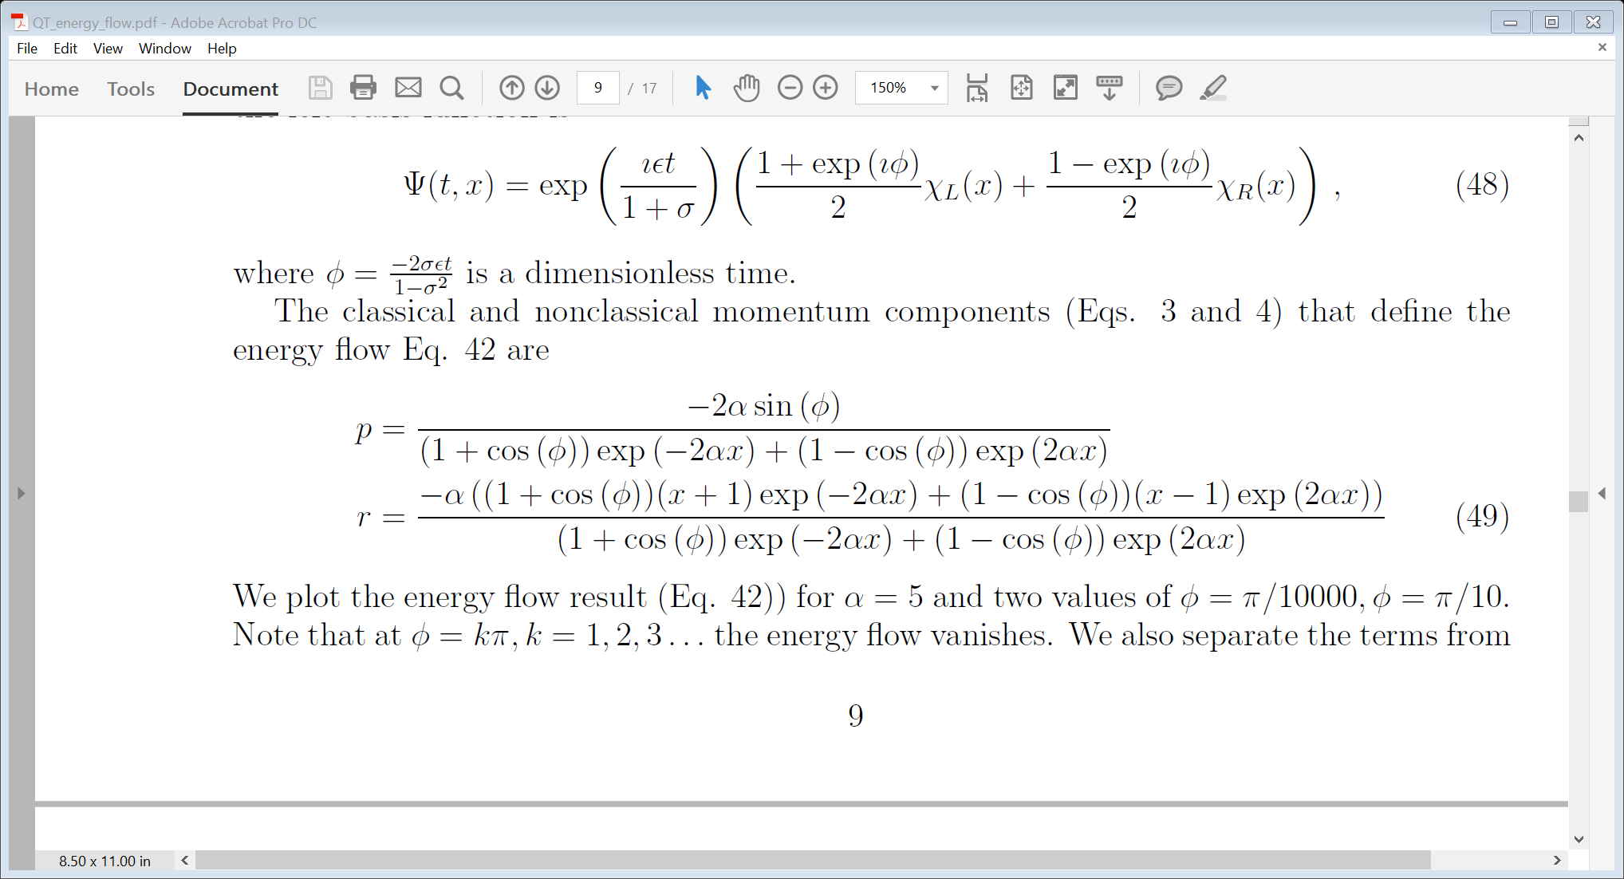
Systems(III): double well

Slide 22
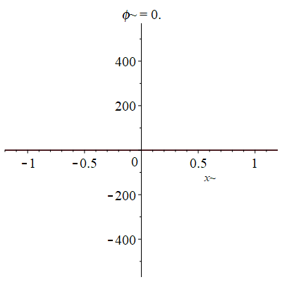
Double well: minima are at ±1. Initial population (at φ=0) is in the left well

Slide 23
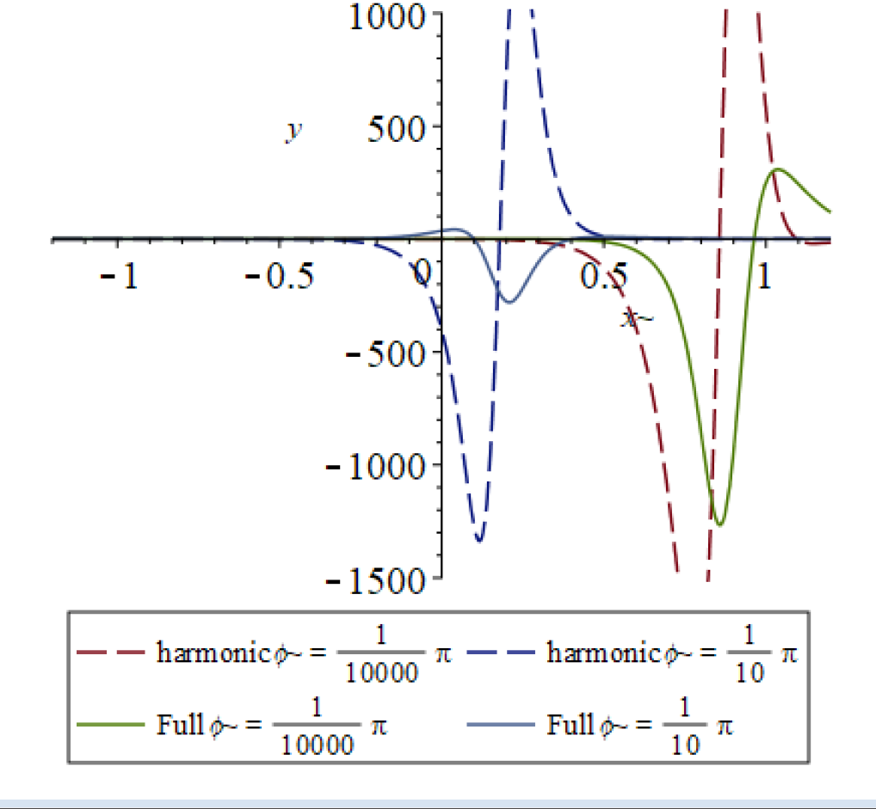
Systems: double well

Slide 24
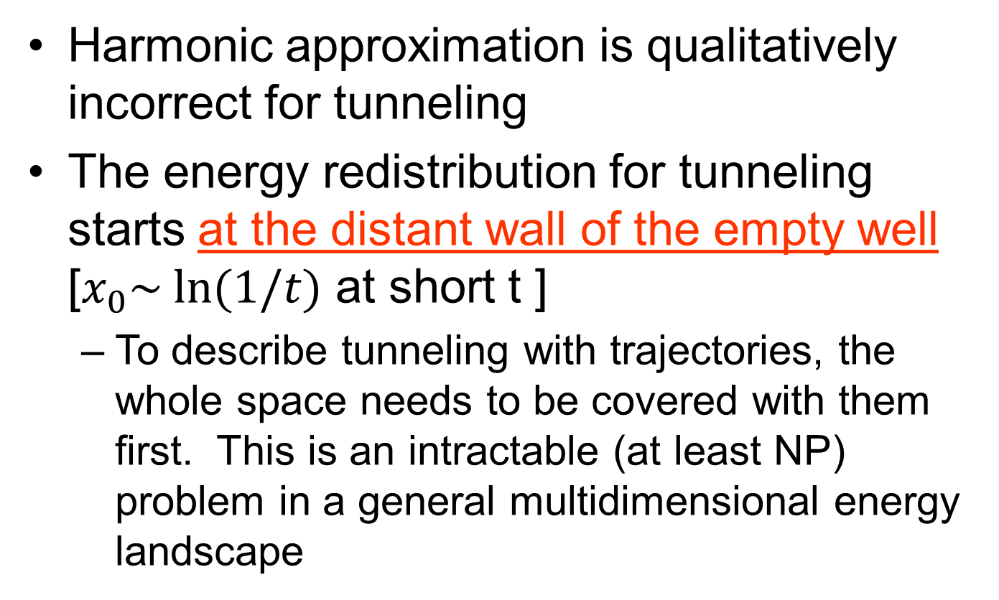
Systems: double well Conclusions
Harmonic approximation is qualitatively incorrect for tunneling
The energy redistribution for tunneling starts at the distant wall of the empty well [$x_{0}\sim ln⁡(1/t)$ at short t ]
To describe tunneling with trajectories, the whole space needs to be covered with them first. This is an intractable (at least NP) problem in a general multidimensional energy landscape

Slide 25
Systems (IV): 2D Quantum-Classical m₀=1, λ=m₀/m
1D
2D

Slide 26
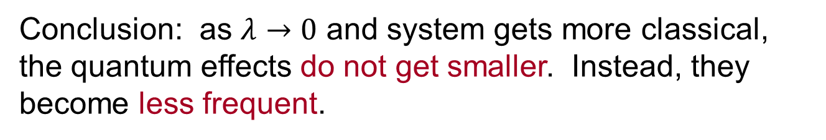
Systems (IV): 2D Quantum-Classical m₀=1, λ=m₀/m
Conclusion: as $λ→0$ and system gets more classical, the quantum effects do not get smaller. Instead, they become less frequent.

Slide 27

To do:
Find workable approximate expression for energy flow
To implement with quantum trajectories
Study non-adiabatic dynamics
Check WKB
Questions?

